Slide 1
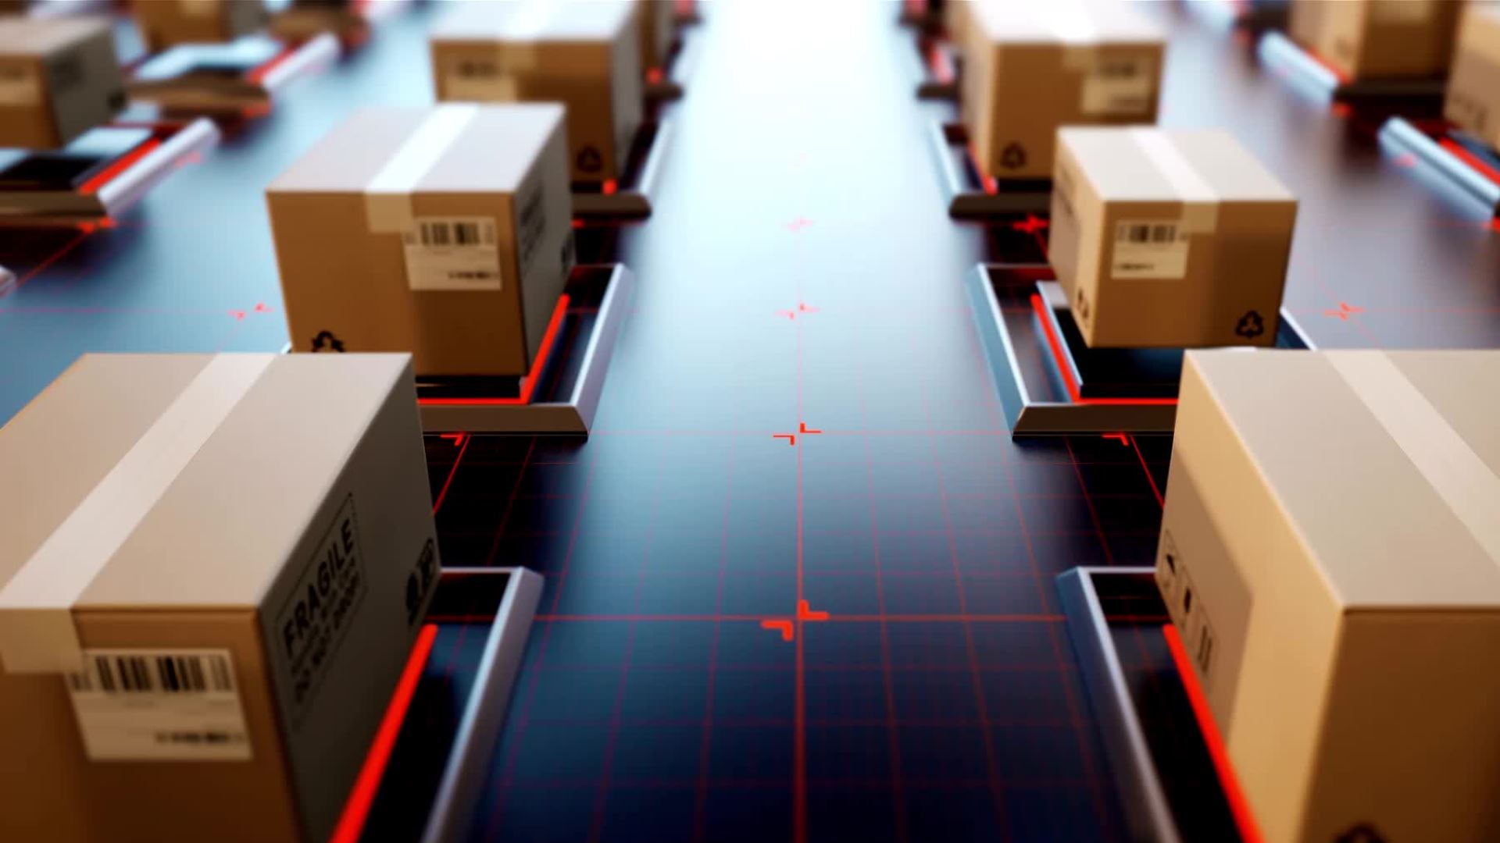
Retail Management System
Team 1 Group Members : Purvakshi Thakkar
Aishwarya Sriyapu Reddy
Bhavya Pranila Sathi

Slide 2
Agenda
Database Objective
Business Rules
Workflow
Entities
ERD
Database Implementation
Table Level Check Constraints
Computed Columns
Encrypted Columns
Views
Reports/Visulization
Conclusion
Future Scope

Slide 3

Database Objectives
The database system enables comprehensive analysis of sales across various channels (in-store, online, pickup) and locations, guiding informed decisions on new store placements and minimizing potential losses by strategically adapting to customer preferences.
By leveraging historical sales data and predictive analytics, the system optimizes inventory management, ensuring timely restocking, efficient allocation of inventory space, and meeting customer demands by fine-tuning inventory levels throughout the year.

Slide 4
Business Rules
Each product belongs to a single category, while each category contains at least one product.
A vendor must be associated with at least one retail store, and similarly, a customer must be linked to at least one retail store.
There are three order types: pickup, delivery, and in-person.
Every order is fulfilled using a single payment method among cash, credit card, debit card, or UPI.
Each customer is associated with a unique phone number.

Slide 5
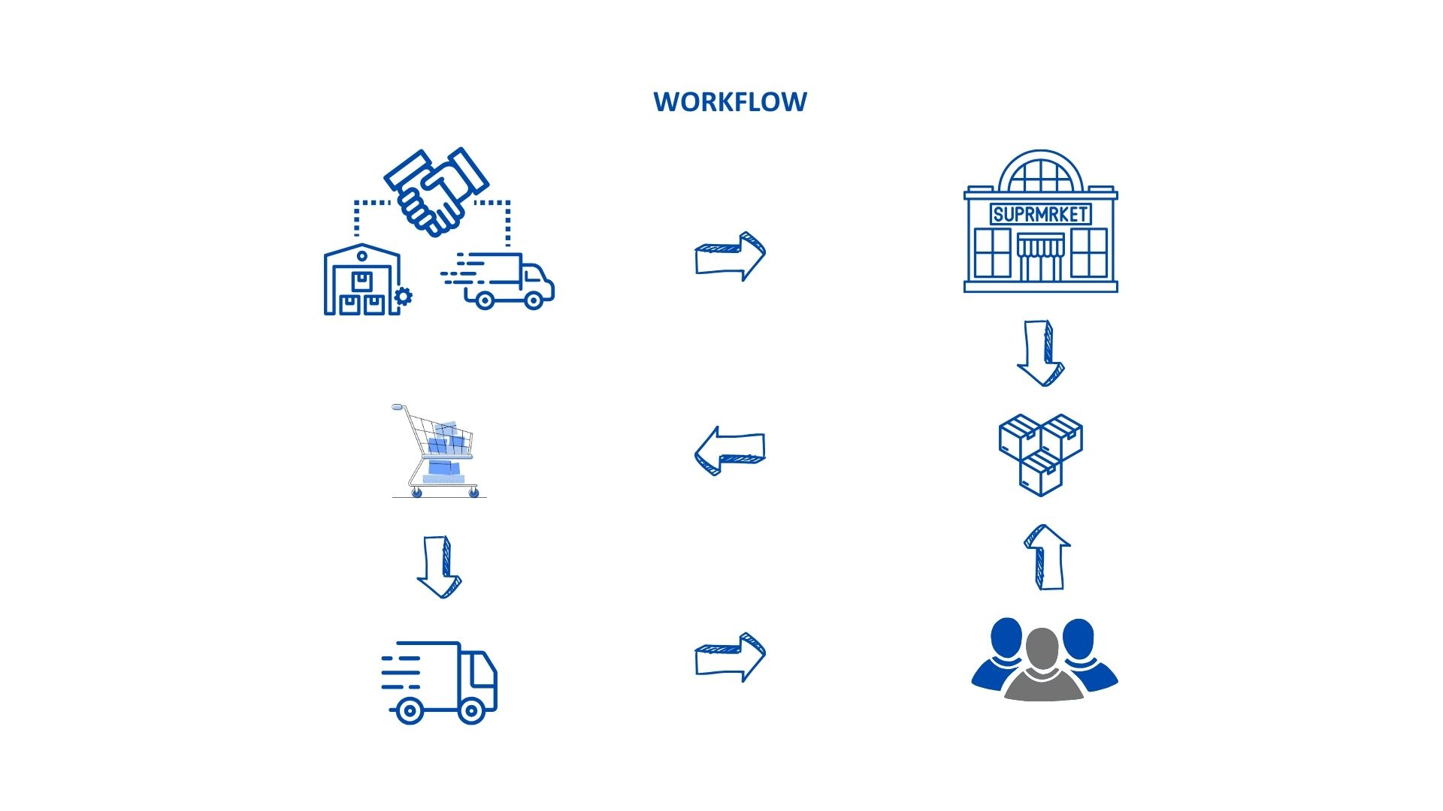

Slide 6
Entities
Retail Store
Vendors
Retail Store Vendors
Product Category
Product
Product Vendors
Customer
Retail Store Customers
Login User
Customer Address
Customer Feedback
Order
Product Orders
Shipping
Payment

Slide 7
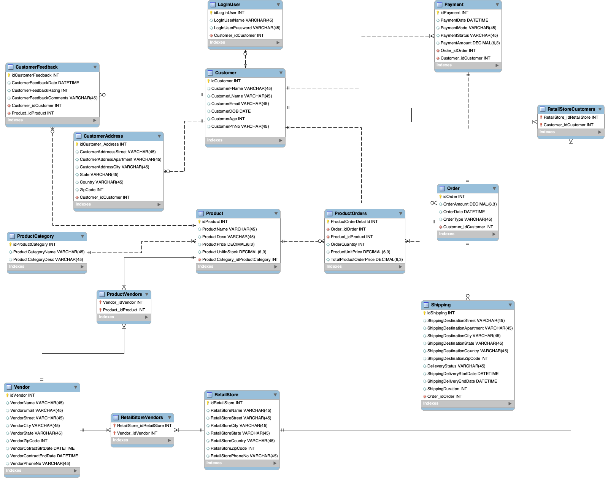

Slide 8
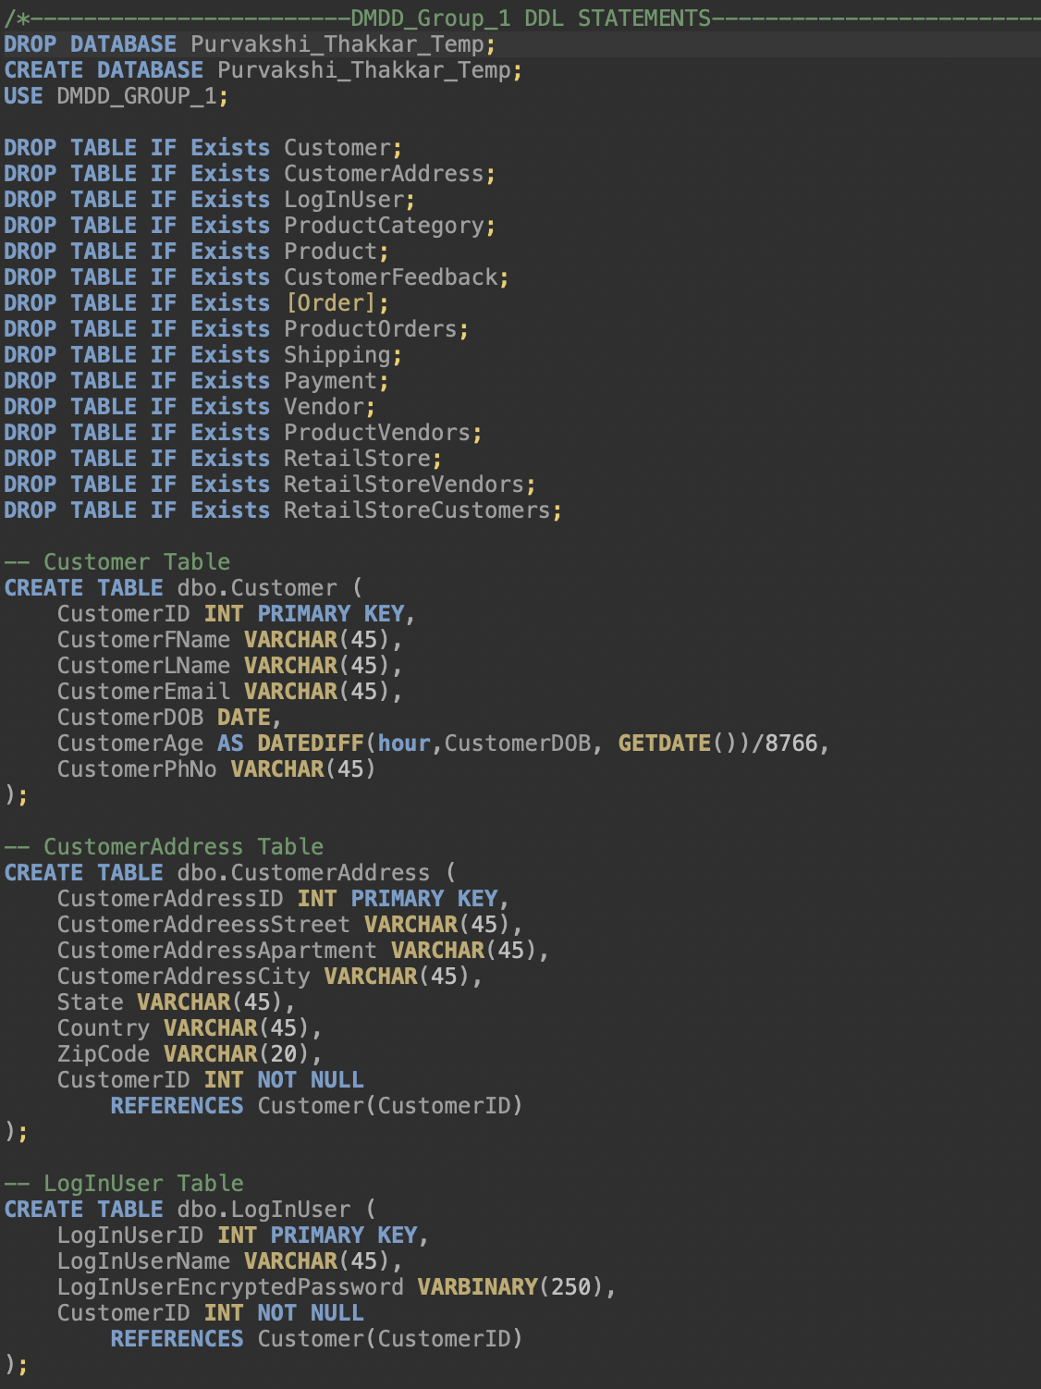
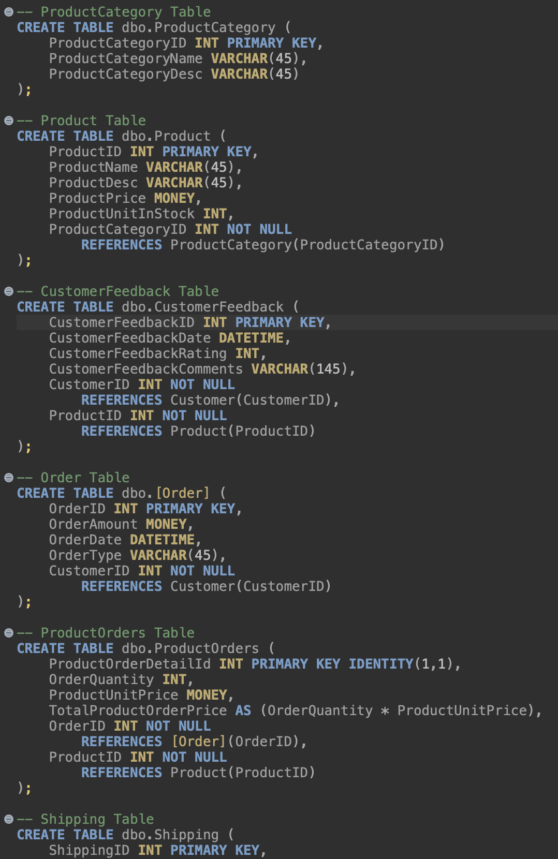
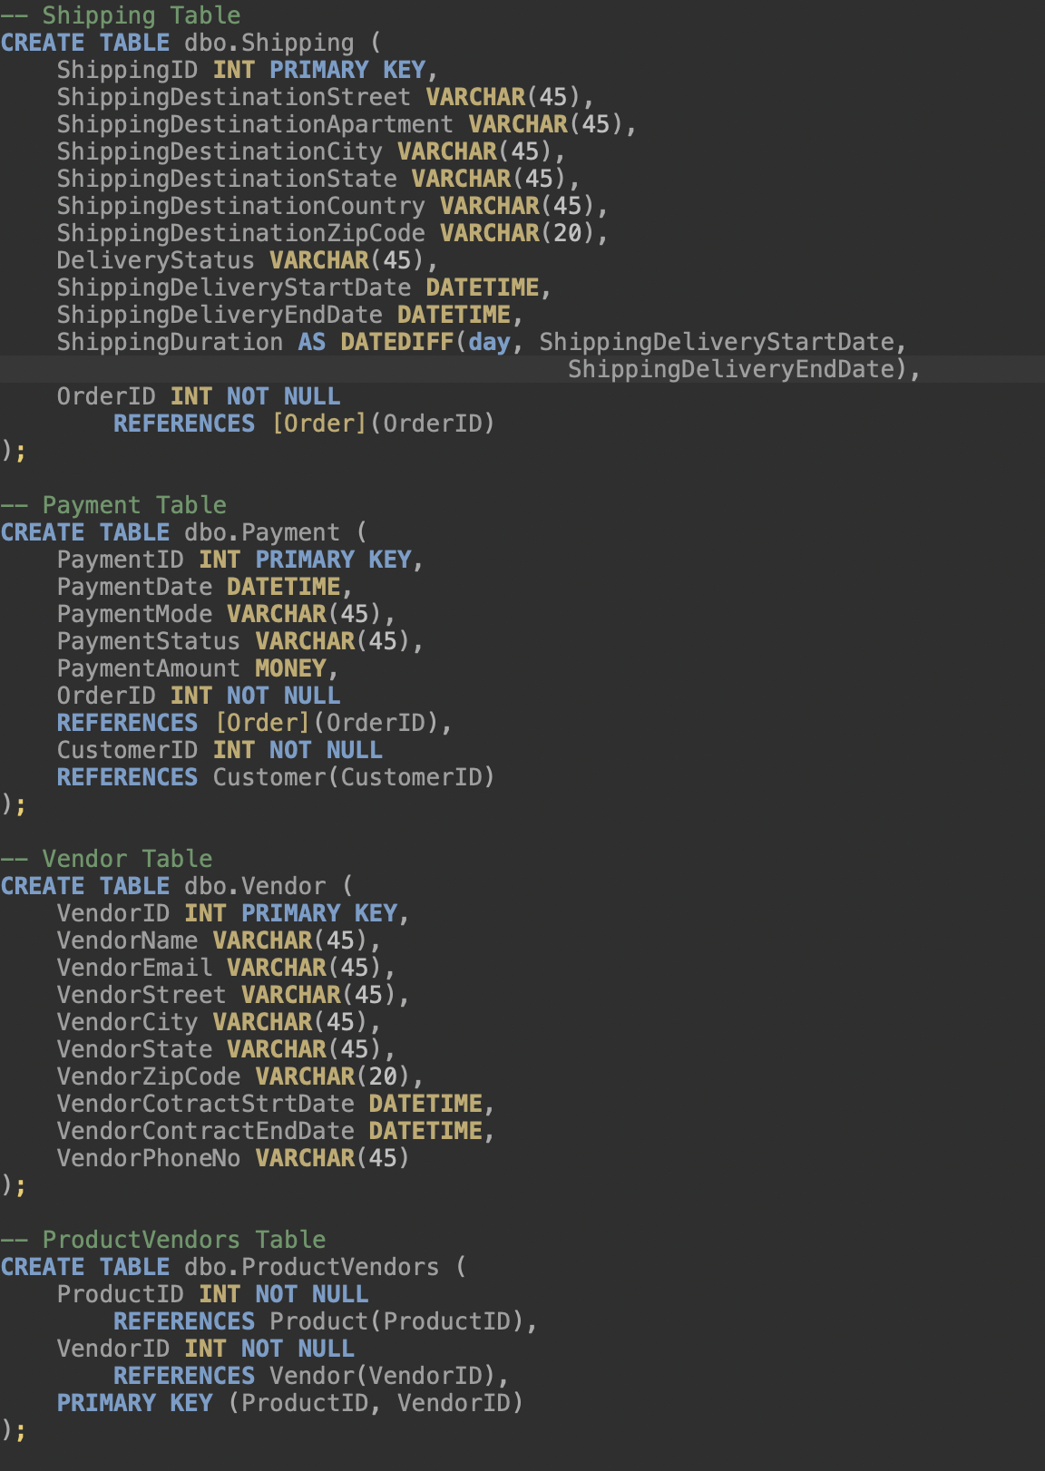
Database Implementation

Slide 9
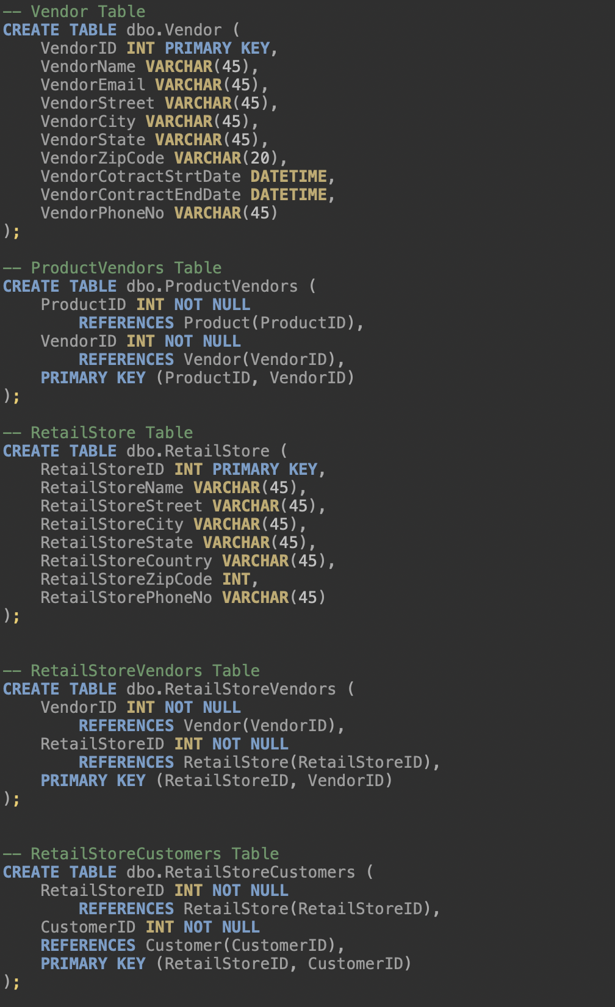
Database Implementation (Continued...)

Slide 10
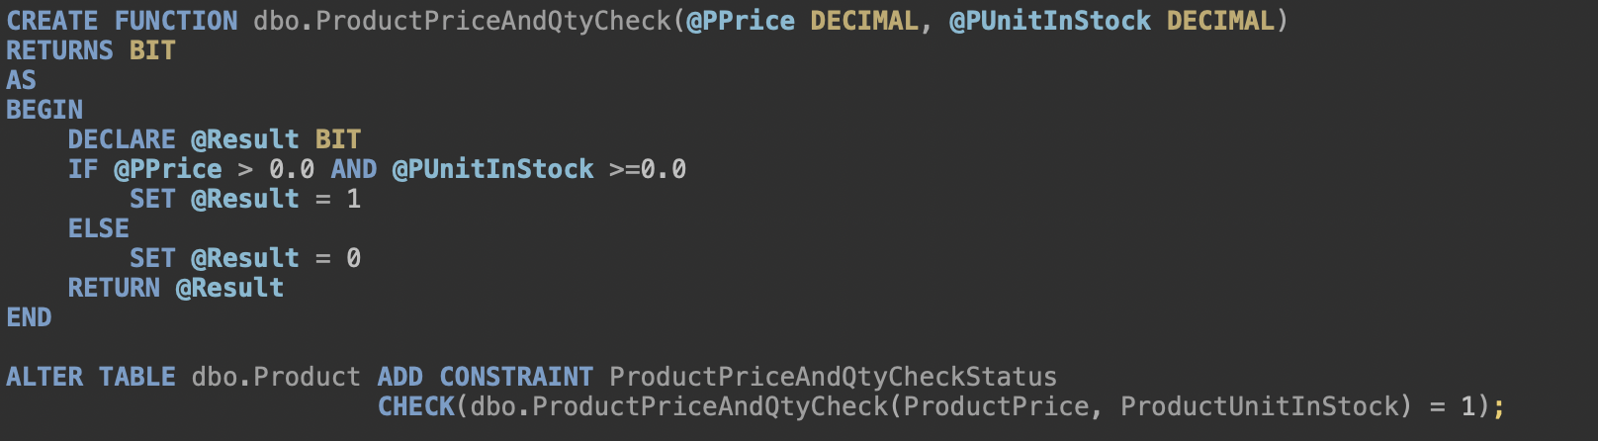
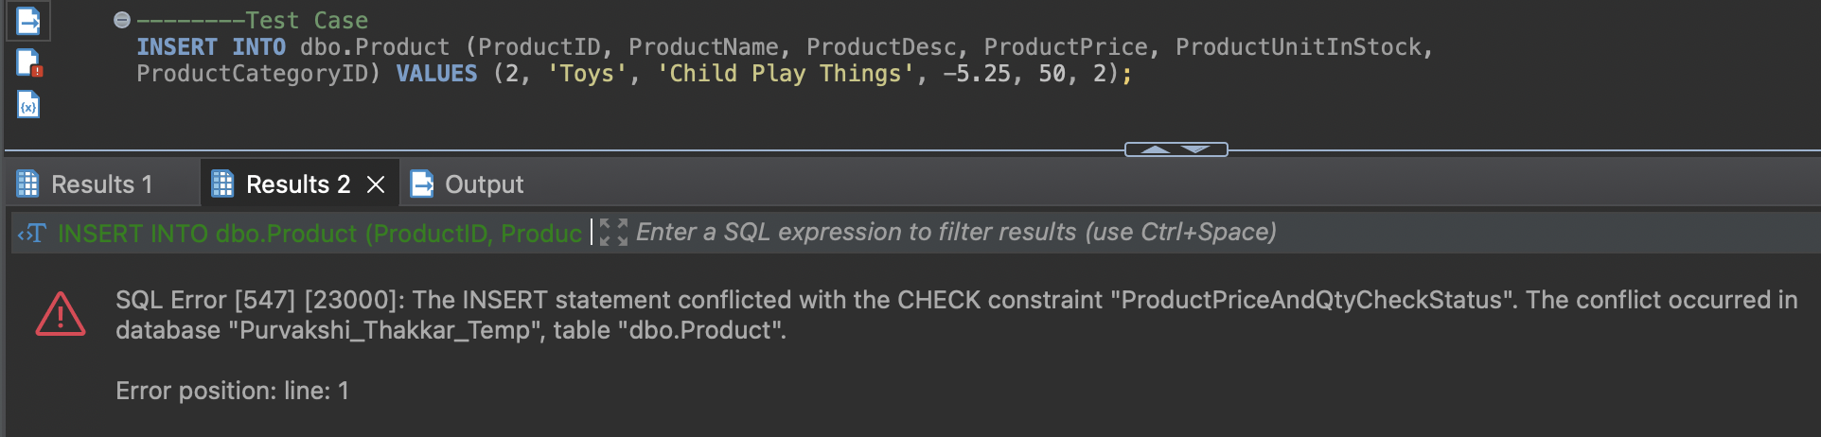
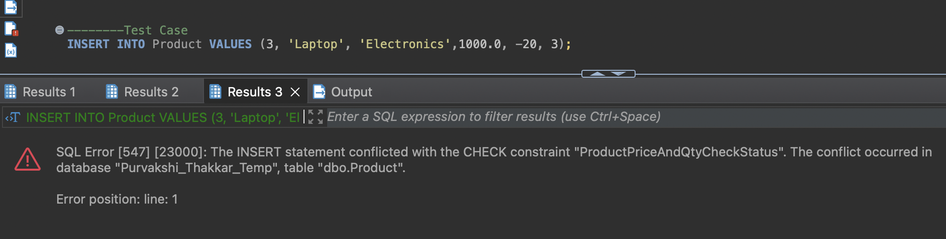



Table Level Check Constraints
Product prices are required to be greater than zero, and the stock levels must not dip below zero according to specified constraints.

Slide 11
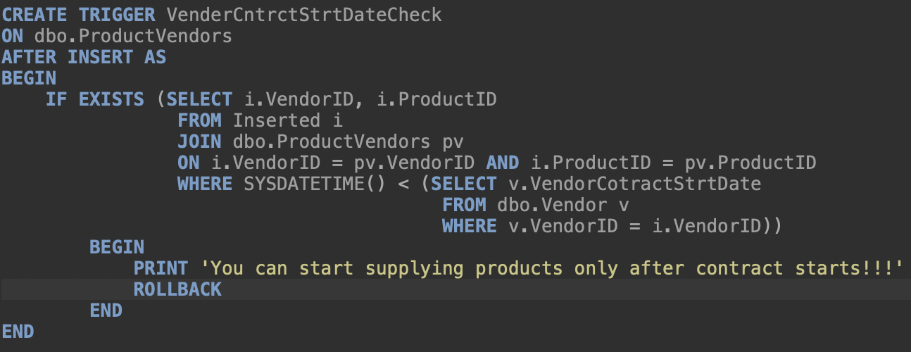
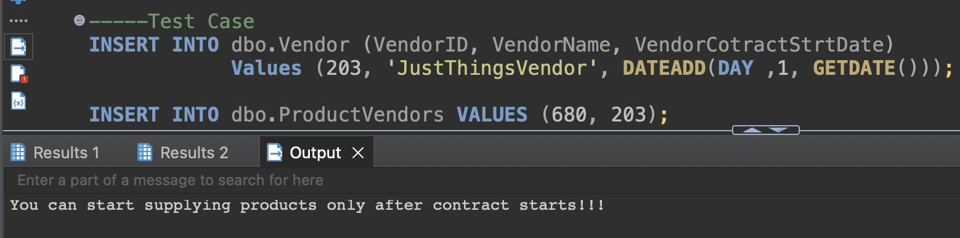
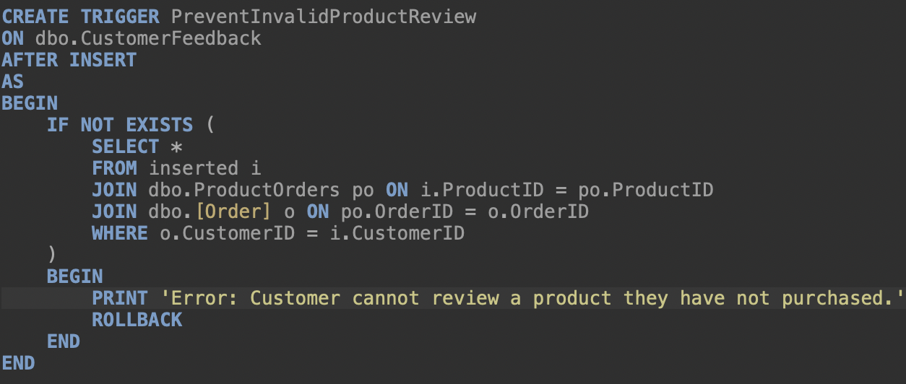
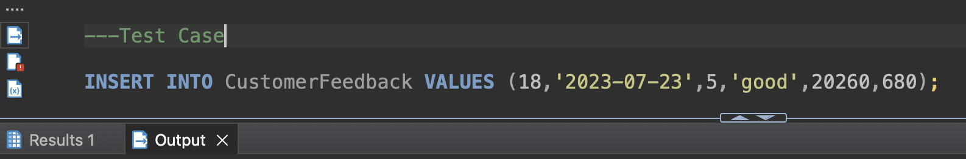



Table Level Check Constraints (Continued...)
Vendors are restricted from supplying products prior to the contract start date according to the specified constraint.
Customers can only review products they have purchased; if a customer hasn't bought a specific product, they cannot leave a review for it according to this constraint.

Slide 12
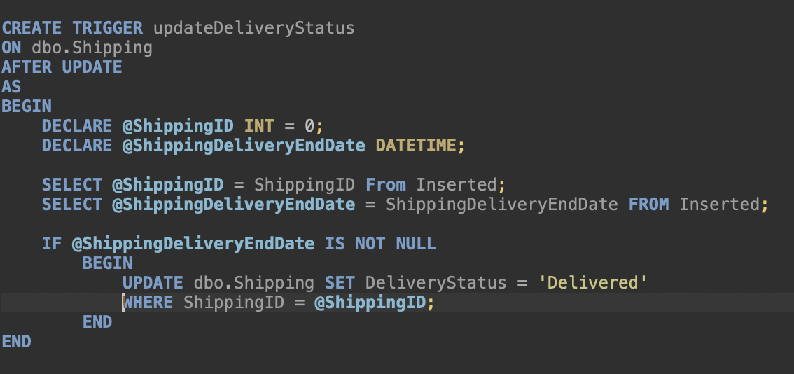
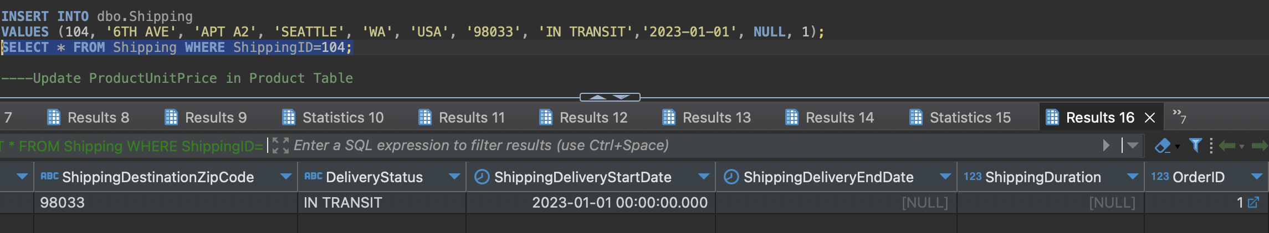
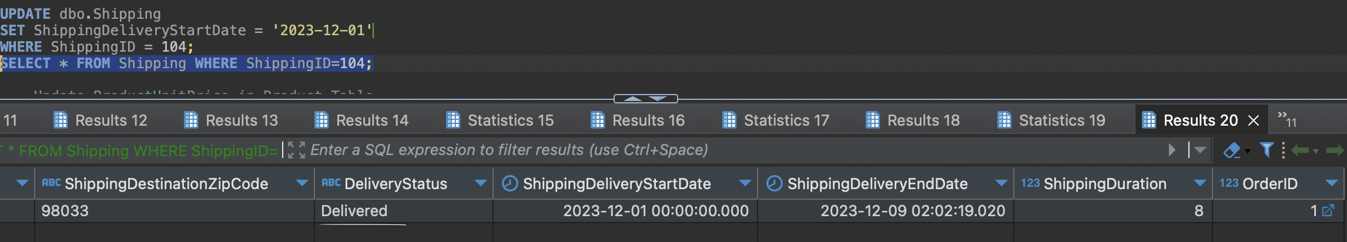


Computed Columns
A trigger is implemented to automatically set the delivery status as "delivered" once the delivery end date is recorded in accordance with this requirement.

Slide 13
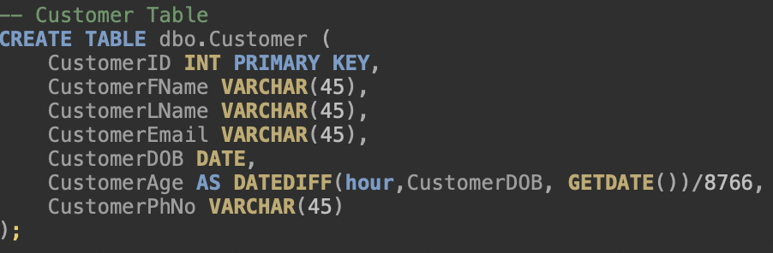
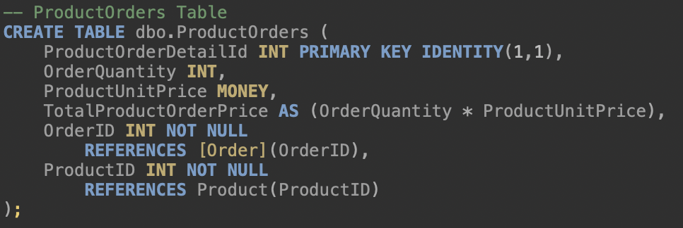
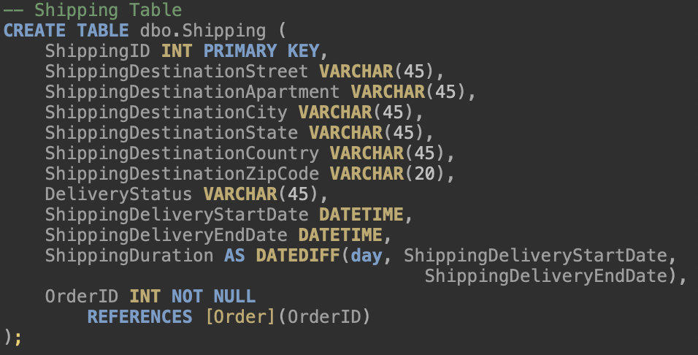



Computed Columns (Continued...)
Customer Age Calculation
Total Product Order Price Calculation
Shipping Duration Calculation

Slide 14
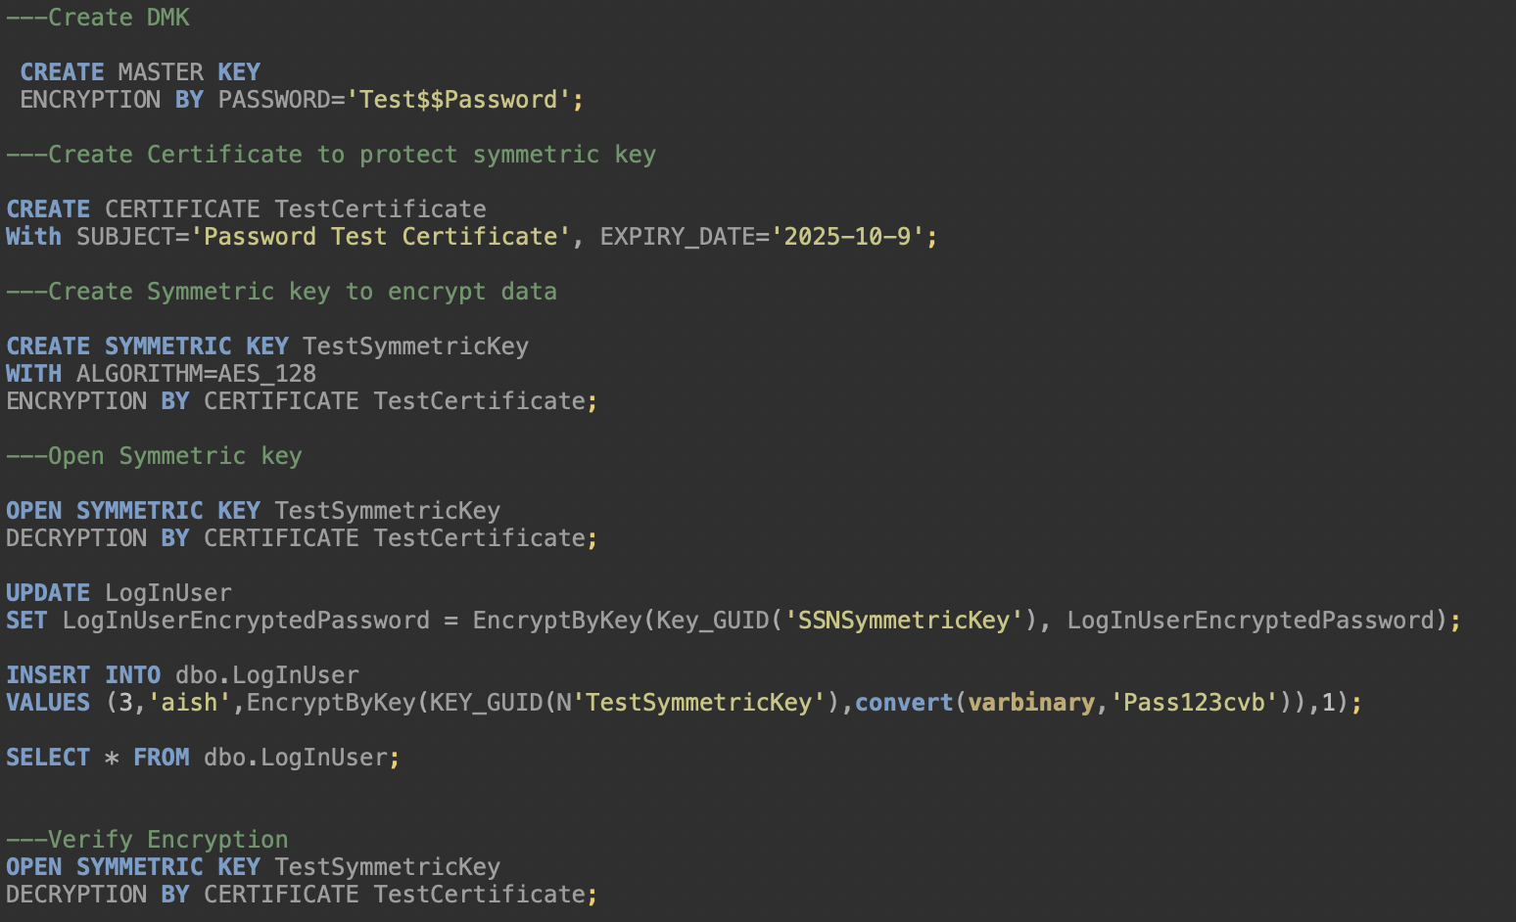
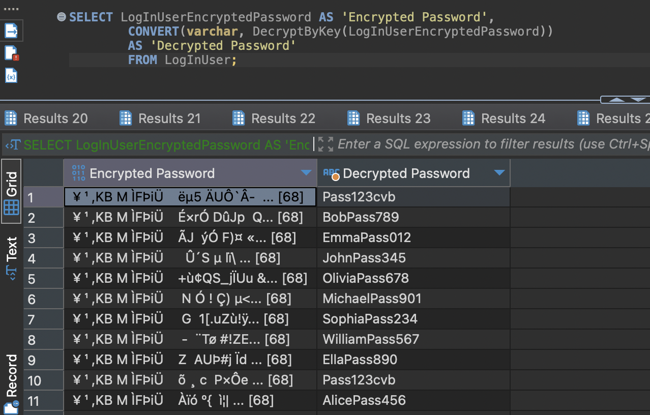
Encryption

Slide 15
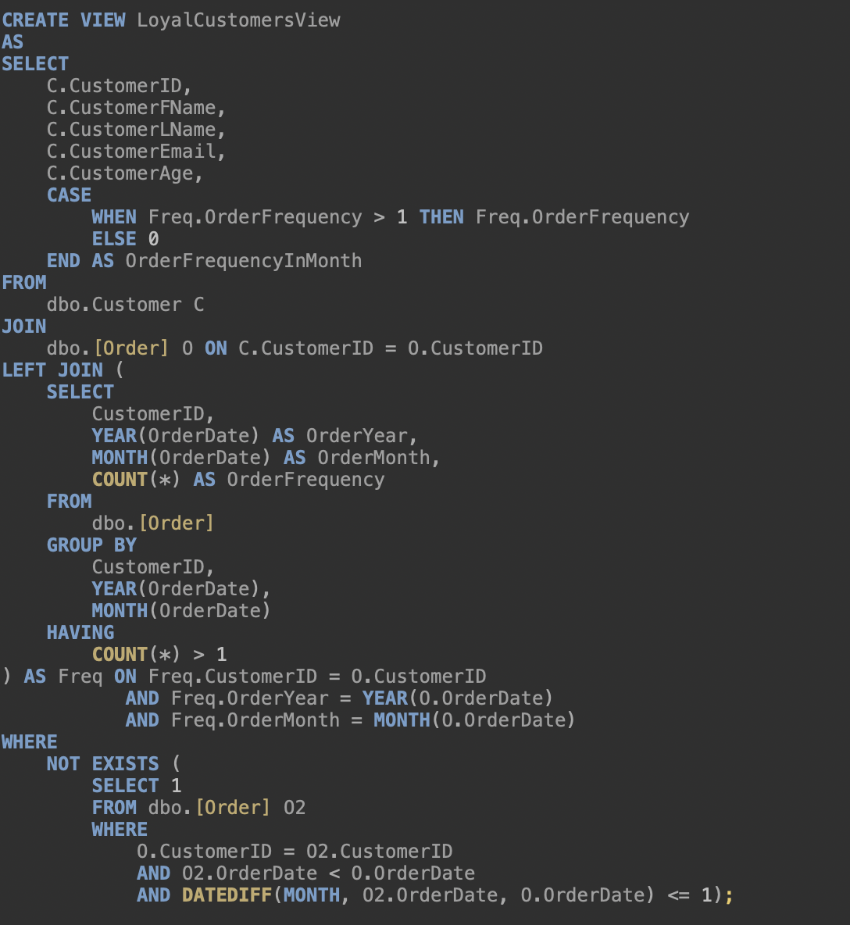
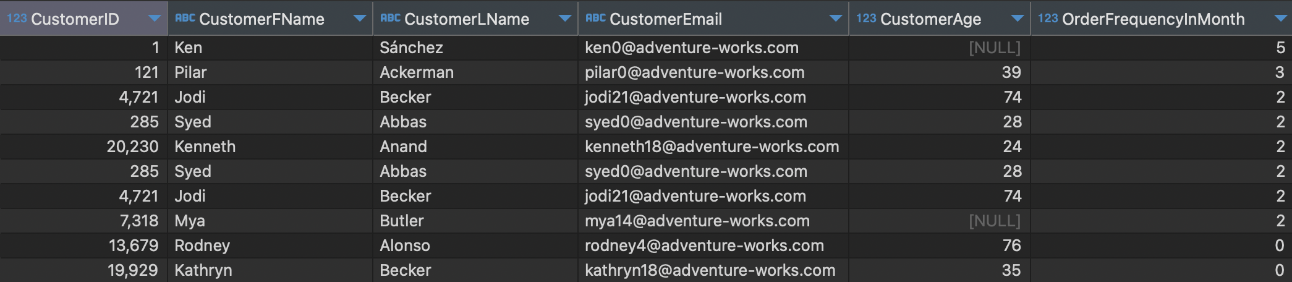
Views
Loyal Customer View Identifying customers who consistently make purchases aids in recognizing potential loyal patrons, enabling targeted marketing campaigns tailored to their preferences and behaviors.

Slide 16
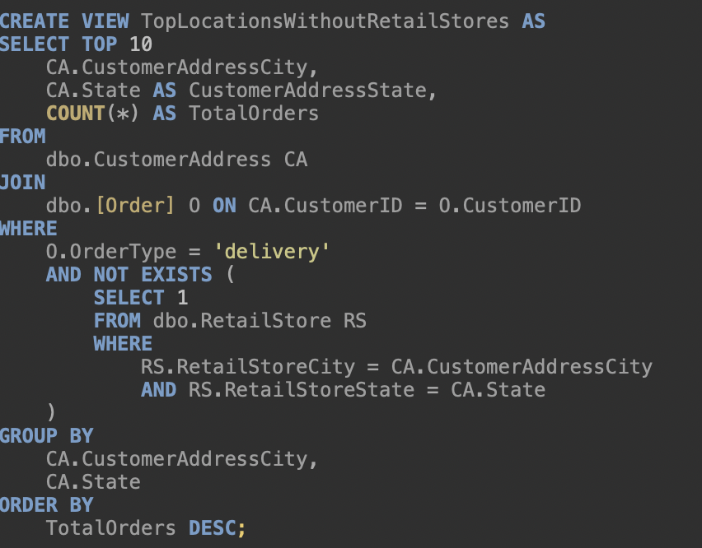
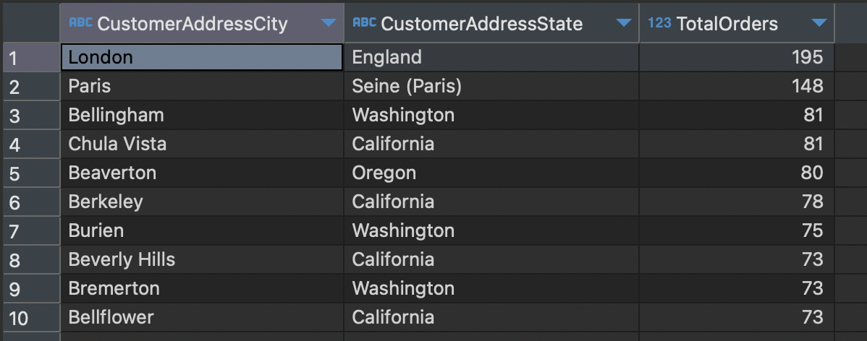
Views (Continued...)
Possible Locations for Retail Stores: These views aid in identifying the top 10 locations without retail stores, yet generating the highest delivery orders. This analysis guides our decision-making for potential store placements in these areas.

Slide 17
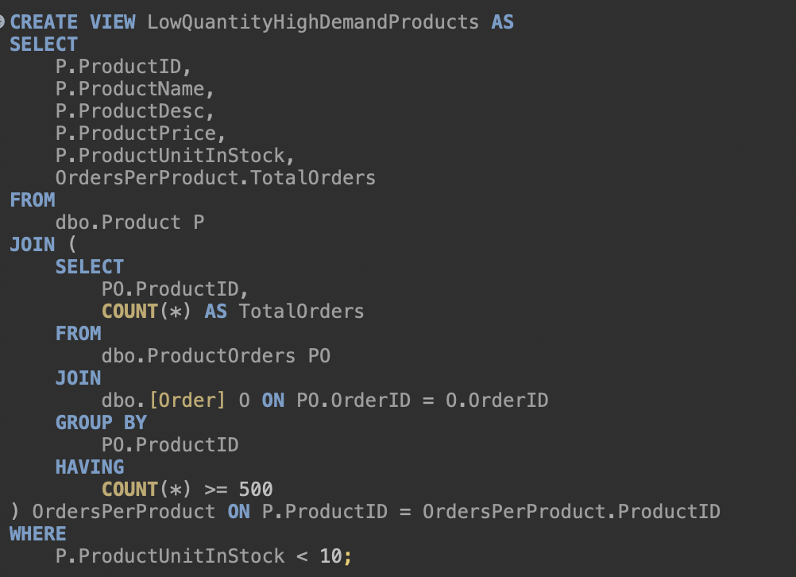
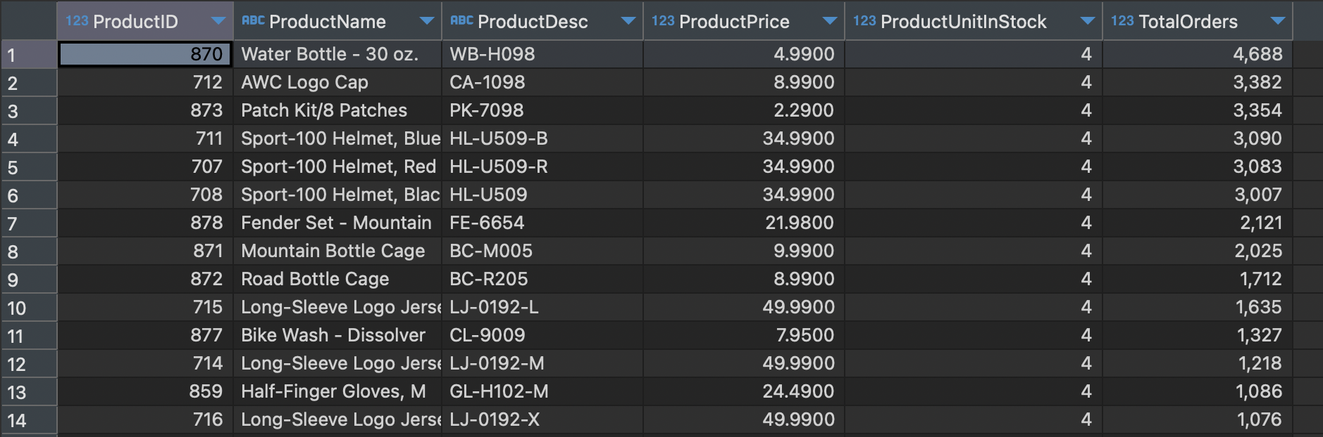
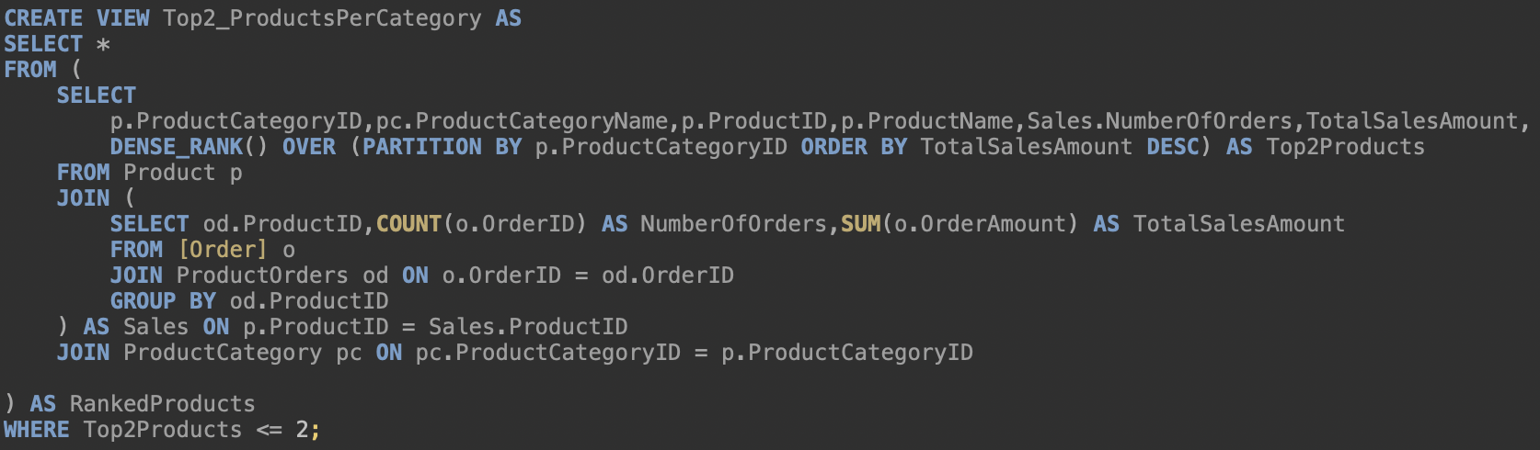
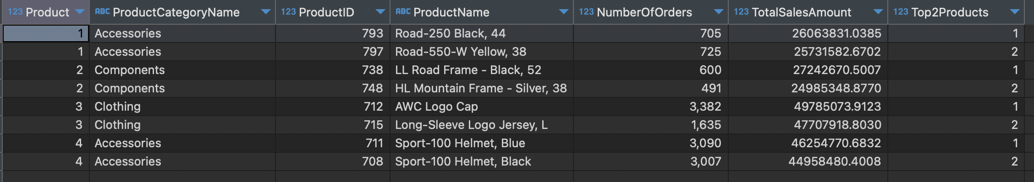
Views (Continued...)
Product of High Demand and in Low Quantity: This view highlights the products in high demand but with low quantities available.
Display Top 2 Products of each Product Category: This view displaying the top two products within each product category based on specific criteria or metrics.

Slide 18
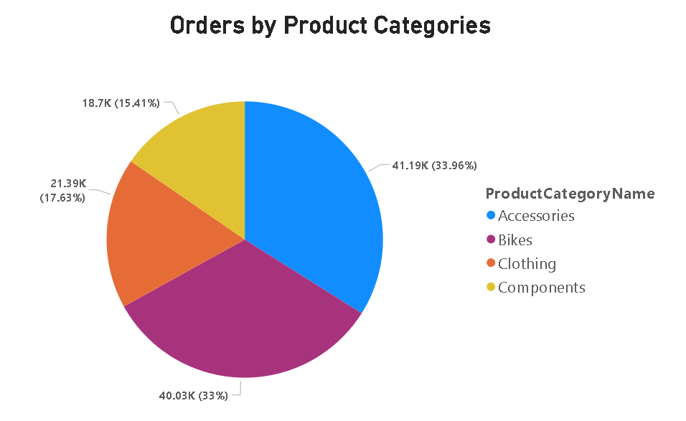
Visualizations

Slide 19
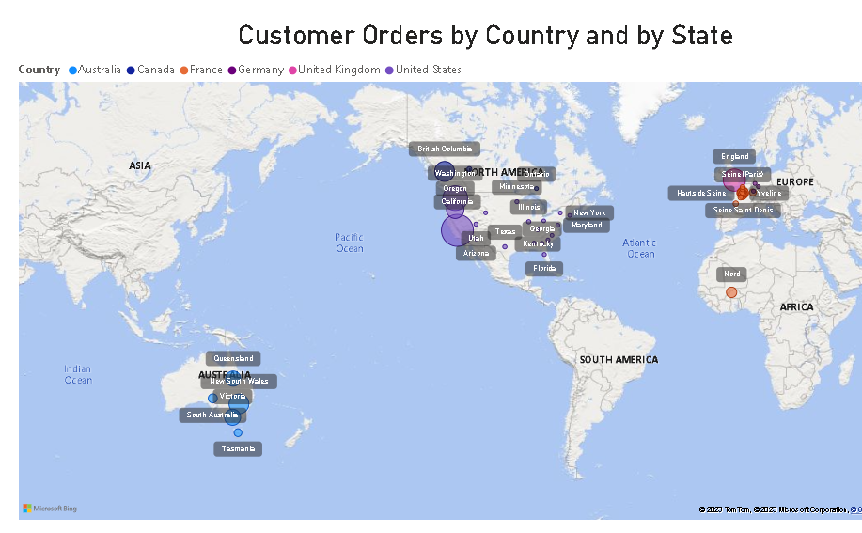
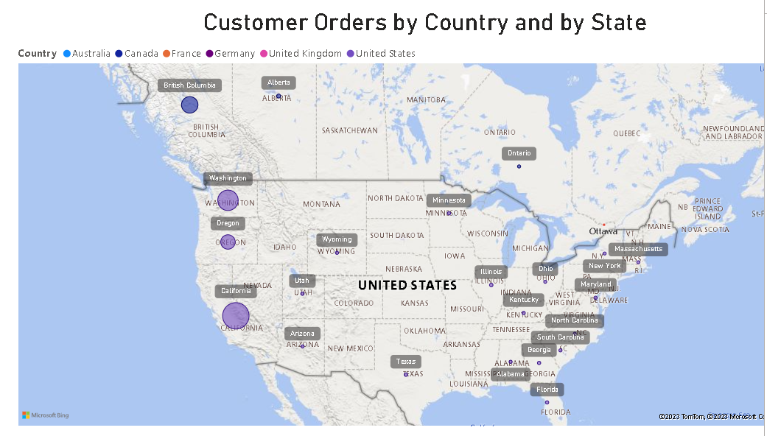
Visualizations/ Reports

Slide 20
Conclusion
Efficient Operations: A good retail system boosts efficiency in managing operations.
Optimized Inventory: It helps in managing stock effectively, reducing excess or shortages.
Better Customer Experience: By integrating sales, inventory, and customer data, it enhances the overall shopping experience.
Informed Decision-Making: Enables smarter decisions by providing valuable insights.
Adaptability: Successful systems adapt to changing trends and embrace technology.
Customer Satisfaction: Prioritizing customer needs leads to sustainable growth and profit.

Slide 21
Future Scope
Advancements in technology, particularly in artificial intelligence and data analytics, will drive more personalized customer experiences.
The integration of online and offline channels will continue to evolve, offering seamless shopping experiences across various platforms.
Moreover, the integration of emerging technologies like IoT, blockchain, AR/VR, and mobile commerce will transform retail operations and customer interactions.
These innovations will redefine how retailers engage with customers, manage inventory, and conduct transactions, setting the stage for a more efficient, interactive, and connected retail landscape.

Slide 22

Thank You!

